Slide 1

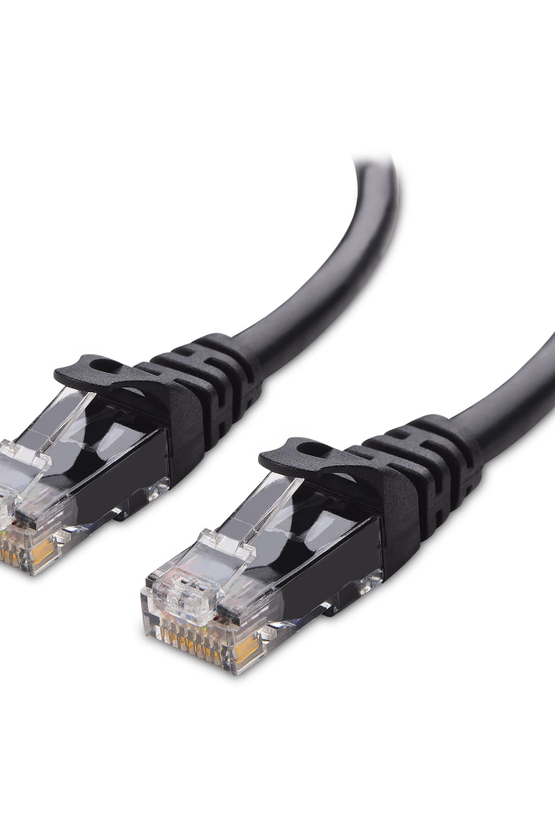

Communication Between Systems
Effective communication is the backbone of distributed systems. Join us on a journey to learn about the key concepts, protocols, and challenges surrounding communication between systems.
by Riska Kurniyanto Abdullah

Slide 2

Key Concepts
1
Distributed Systems
2
Communication
Distributed systems are composed of multiple components that coordinate their actions through message passing.
Communication refers to the transmission of information between systems, components, or processes.
3
Seamless Communication
Seamless communication is essential for coordination and consistency in distributed systems.

Slide 3
Communication Models
1
2
3
4
Request-Response
Publish-Subscribe
Message Passing
Remote Procedure Call
A request-response model involves a client sending a request to a server, which responds with the requested information.
In a publish-subscribe model, publishers send messages to a topic, and subscribers receive those messages based on their subscriptions.
A message passing model involves systems exchanging messages with each other.
RPC enables one program to execute code in another program running on a remote machine, as if it were a local function call.

Slide 4
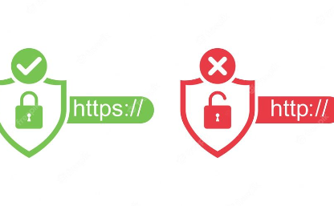
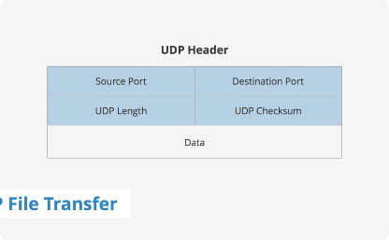
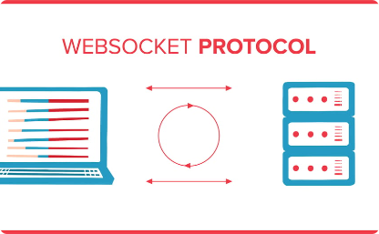
Communication Protocols
HTTP and HTTPS
TCP and UDP
HTTP (Hypertext Transfer Protocol) is a communications protocol used for transferring data between servers and clients on the World Wide Web. HTTPS adds a layer of encryption that secures the communication.
TCP (Transmission Control Protocol) provides reliable, ordered, and error-checked delivery of data between applications. UDP (User Datagram Protocol) is a protocol for sending data that does not require a dedicated end-to-end connection.
WebSocket
WebSocket is a protocol that enables two-way communication between client and server with a single TCP connection.

Slide 5
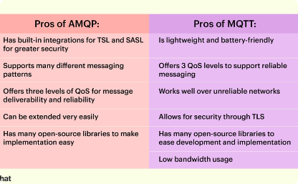
Communication Protocols ...(2)
MQTT and AMQP
MQTT (Message Queuing Telemetry Transport) is a publish-subscribe protocol used to connect devices to the internet. AMQP (Advanced Message Queuing Protocol) is a messaging protocol designed for asynchronous message-oriented middleware.
WebSocket
WebSocket is a protocol that enables two-way communication between client and server with a single TCP connection.

Slide 6
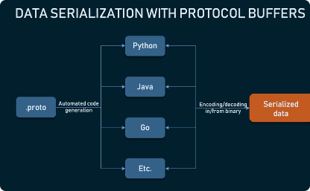
Communication Protocols
gRPC
gRPC is an opinionated, high-performance, open-source framework that makes it easy to build distributed systems.
WebSocket
WebSocket is a protocol that enables two-way communication between client and server with a single TCP connection.

Slide 7

Message Formats
1
XML
2
JSON
XML is a markup language that allows you to describe data. It is a widely used data format because it can be easily processed by a variety of applications.
JSON is a lightweight data interchange format that is easy for humans to read and write and easy for machines to parse and generate.
3
Protocol Buffers
Protocol Buffers is a language-agnostic binary serialization format used to store and transmit structured data.

Slide 8
Security and Authentication
1
Secure Communication Channels
It is essential to use secure communication channels to prevent confidential information from being intercepted.
2
Authentication Mechanisms
API keys, OAuth tokens, digital signatures, and other authentication mechanisms can be used to ensure that requests are being made by legitimate sources.

Slide 9
Asynchronous vs. Synchronous
Asynchronous
Synchronous
Does not block the sender
Blocks the sender until a response is received
Allows for multiple requests to be processed at the same time
Enforces strict ordering of operations
Can simplify software development and testing
Can help improve performance and scalability

Slide 10
Communication Patterns
1
2
3
4
Point-to-Point
Broadcast
Multicast
Anycast
Broadcast communication enables messages to be sent to all connected systems.
Multicast enables messages to be broadcast to a subset of the connected systems.
In an anycast communication model, messages are sent to the nearest or most appropriate receiver.
Point-to-point communication is a simple one-to-one communication between systems.

Slide 11
Middleware and Integration
Middleware
Integration Platforms
Middleware is software that sits between components in a distributed system and provides services such as message routing, security, and fault tolerance.
Integration platforms are used to connect disparate systems and applications together. They often provide communication protocols, message transformation, and routing capabilities.

Slide 12

Challenges
1
Latency and Real-time Communication
2
Reliability and Message Delivery
Latency can affect the responsiveness of a system, especially in real-time communication scenarios.
Message delivery is not guaranteed, and messages can get lost or corrupted.
3
Scalability and Handling Increasing Loads
4
Consistency and Synchronization
As the number of clients and messages increase, it can be challenging to scale the system while maintaining performance.
Ensuring consistency across all systems and processes can be a significant challenge in distributed systems.

Slide 13

Case Study: RESTful API
RESTful APIs are one of the most popular communication protocols for distributed systems. They are simple, lightweight, and language-agnostic, making them an ideal choice for many applications.

Slide 14
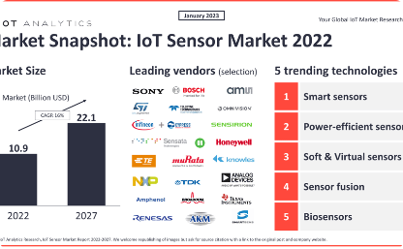
Case Studies… IoT
IoT Applications
IoT applications often rely on efficient and reliable communication between devices, sensors, and servers to collect and process data.

Slide 15
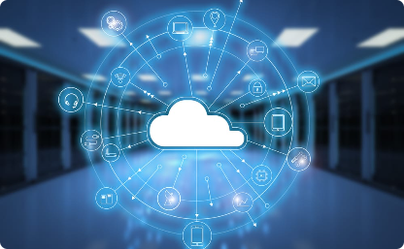
Case Studies… cloud
Cloud Services
Cloud services require robust communication protocols to handle the high volume of requests and data transfer between clients and servers.

Slide 16

Case Studies… Financial Transactions
Financial Systems
Financial systems require secure and reliable communication channels to ensure the privacy and integrity of financial transactions.

Slide 17

Case Studies… Medical
Medical Devices
Medical devices require low-latency, high-frequency, and reliable communication to monitor and deliver crucial medical information to healthcare providers.

Slide 18

Future Trends
1
Microservices
2
Serverless Architecture
Microservices use a distributed architecture to build and deploy modular, independent, and scalable services.
Serverless architecture allows developers to build and run applications without worrying about the underlying infrastructure, making it ideal for event-driven systems.
3
Edge Computing
Edge computing refers to the processing and storage of data near the edge of the network, reducing latency, and improving performance in distributed systems.

Slide 19
Best Practices
1
Design for Failure
Expect communication failures and design the system to handle them gracefully.
2
Choose the appropriate protocols, patterns, and security measures
The right choice of protocols, patterns, and security measures can make a significant impact on the effectiveness and scalability of your system.

Slide 20
Conclusion
Effective communication between systems is essential for building robust, scalable, and reliable distributed systems. We've covered the key concepts, protocols, and challenges associated with communication between systems. We hope this presentation has increased your understanding of how to design, build and maintain distributed systems that communicate effectively.

Slide 21

Q&A
Thank you for joining us for this presentation. We welcome your questions and feedback. Please feel free to reach out to us if you have any further queries.

